Slide 1
SVA-BMP-BASE Power

Slide 2
BASE Power Linear Regulators
7
LM338
Min. 7A Peak Output Current
Short circuit protection
5
LM108x & LMS15x series
High current
1.2 – 1.5V max dropout
LM1086 available in WSON package
LM317-N/337-N series
LM317A: Superior line and load regulation
Small SOT-223 package available
Military and space grade available
3
Iout (A)
1.5
LM1117-N
Superior load regulation
Tiny WSON package available
Line and Load transient performance
0.8
0.5
DSBGA package
LM317L: 3 to 40V, 150mA
LM78L05:6.7 to 35V, 100mA
0.1
Notes:
LM317 - 1%, HV, SOT223; LM317L – CSP; LM1117 – WSON; LM1084/85 – 29V-3A,5A

Slide 3
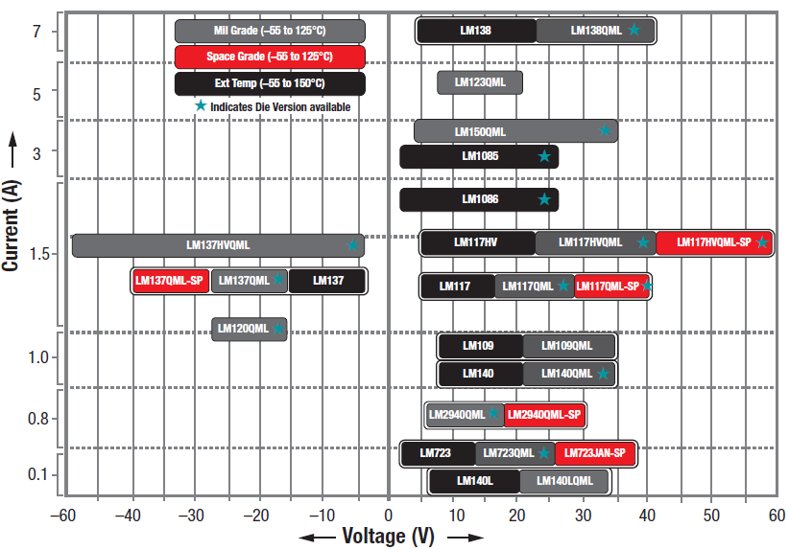
Linear regulators for defense, aerospace & extended temperature requirements

Slide 4
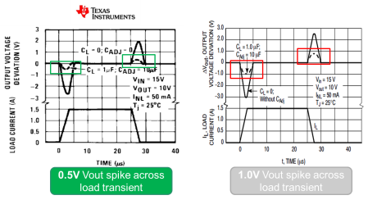
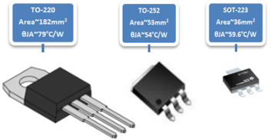
LM317A – Best in class accuracy, performance & size
LM317AEMPX
Highest Accuracy
Smaller and unique package
Cost-competitive compared to other packages
Notes:
If surface area were to be the only consideration, the SOT-223 and the WSON would be packages of choice today. This is particularly true in handheld applications where PCB space is a common concern. For these types of applications, the LM1117-N in the WSON package and the LM317A in the SOT-223 package are of interest. Of note is that ThetaJA for the SOT-223 package can be reduced to approximately 55°C/W by taking proper precautions in PCB design. This is further explained in the section on heat sinks in the LM317A datasheet.

Slide 5
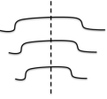
LM3880-Q/LM3881: Power Sequencers
Features
Benefits
Power Up and Down Sequencing
Programmable time delay between outputs
Programmable power down sequence
Reverse of Power up is standard
LM3880-Q: Six timing options released, SOT-23-6, 3mm*3mm
LM3881: Timing programmable by one external capacitor VSSOP-8
Input voltage: 2.7V to 5.5V
20µA Quiescent Current
3 Sequenced Outputs – can be cascaded for more channels
Easy to use, no firmware required
Flexible options for different timing
Low Iq for standby efficiency
Automotive Grade (LM388xQ) available
Up 1→2 →3
Applications
Down 3→2 →1
Power supplies for FPGAs, uProcessor, DSPs and digital ASICs
Multiple rail systems that need sequencing to control in-rush currents or latch-up conditions.

Slide 6
LP299x - DDR Termination Regulators
Features
Benefits
Support Suspend to RAM function
Wide Vin range:
Please see table for details
Load Current:
0.5A (LP2996A/97/98 for DDRIII)
1.5A (LP2995/96/98 for DDRI and DDRII)
Wide Junction temperature
Please see table for details
Linear Topology with Source & Sink capability
Separate power for analog and output driver for flexibility
Ambient temperature up to 85-105C possible with junction max temp of 125C
Exposed pad provides better thermal performance
Sense input for remote sensing or level shifting
VTT = VDDQ/2 without need for external resistor divider
Applications
SSTL-18, SSTL-2 and SSTL-3 Termination
HSTL Termination
Automotive Infotainment
Industrial/Medical PC
6

Slide 7
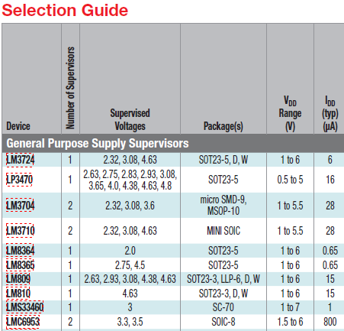
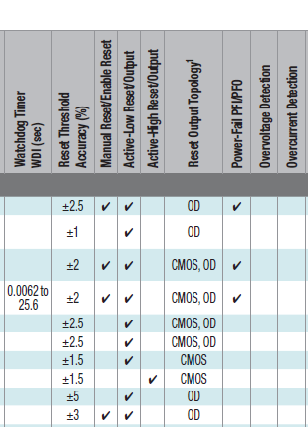
Voltage Supervisor Portfolio
Wide choice of thresholds, 1% acc.
Programmable WDT
Low Iq / NCP303 equivalent
Low cost, Small package
PCI 2.1, 3.3v/5V monitor

Slide 8
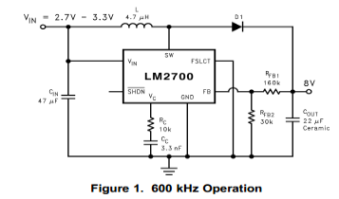
LM2700: 615kHz/1.25MHz Step-up PWM DC/DC Converter
Features
Benefits
Input voltage range of 2.2V to 12V
Switch current up to 3.6A
Output voltage up to 17.5V
Fixed switching frequency of 615/1.25MHz
Adjustable soft-start
SHDN pin
Operates from 3.3V and 5V supplies
High current rated switch for LED applications
Easily adjustable high frequency for small solution applications
Applications
Automotive Digital TV Tuner
LCD Bias Supplies
LED Lighting
Ref Designs: AN1394

Slide 9
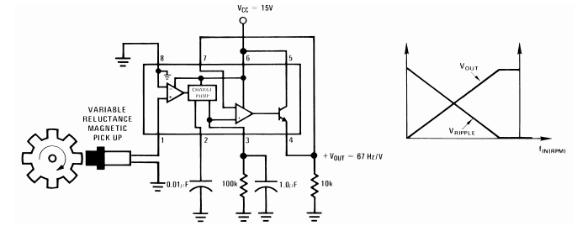
LM2907/17: Frequency to Voltage Converter
Features
Benefits
50 mA Sink or Source to Operate Relays, Solenoids, Meters, or LEDs
Frequency Doubling for Low Ripple
Requires only one RC Network
Built-In Zener on LM2917
Monolithic Design
Simple Design
VOUT = FIN x VCC x R1 x C1
Ground Referenced Tachometer Input: Interfaces Directly With Variable Reluctance Magnetic Pickups.
Two Configurations:
8-Pin Device with Ground Referenced Tachometer Input
14-Pin Device with Differential Tachometer Input and Uncommitted Op Amp Inputs
Active Shunt Regulator: Regulator Clamps provide stable frequency to voltage and frequency to current operations with any supply voltage and a suitable resistor.
Applications
Over/Under Speed Sensing
Frequency to Voltage Conversion (Tachometer)
Speedometers
Cruise Control
Automotive Door Lock Control

Slide 10
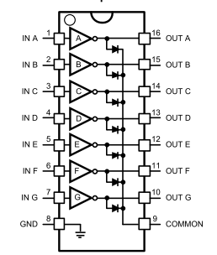
DS2003: Extended Temperature 50V, 350mA Seven Channel Darlington Array
Features
Benefits
Output Leakage Current I_{CEX}= 20uA
High-voltage outputs supports up to 50V
350mA collector current for channels (Single Output)
Output clamp diodes for inductive loads
Temp Range:
T_{A}:-40°C to 85°C (DS2003C)
T_{A}:-40°C to 125°C (DS2003T)
16 pin SOIC Package
Improved leakage current compared to industry standard ULN2003 → almost 3x decrease
Supports high current and voltages from low voltage control signal
No external diode needed for inductive loads on channels
Supports channel paralleling for higher current demand
Applications
Relays and Inductive Drivers in Telecom, After market Automotive and Industrial applications
Lamp and LED Displays
Logic Driver

Slide 11
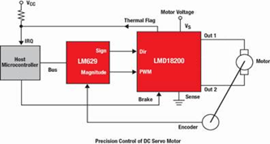
LMD18200/01/45: 3A, 55V H-Bridge for DC Motors
Features
Benefits
Low RDS(ON) per Switch at 3A:
3A continuous output Current Capability
Supply Voltages up to 55V
Typical RDS(ON) of 0.33Ω
Internal Protection Features:
No “Shoot-Through” Current
Thermal Warning Flag at 145ºC
Thermal Shutdown at 170ºC
Internal Clamp Diodes
Shorted Load Protection
Monolithic Design
Simple Design
Reduced BOM Cost and Solution Size: Package already incorporates a heat-sink, no need for additional heat-sinks/fans.
Immaculate Protection: Inductive load protection for each switch, built-in diodes also feature quick reverse recovery. 10A Internal Current Limit!
PWM Flexibility: Drive either a simple, locked anti-phase PWM, or Sign/Magnitude PWM for more precise control.
Applications
DC and Stepper Motor Drives
Position and Velocity Servomechanisms
Factory Automation Robots
Numerically Controlled Machinery
Computer Printers and Plotters
Part Number | Current Sensing | Speed Control
LMD18200 | YES | PWM
LMD18201 | NO | PWM
LMD18245 | YES | DAC

Slide 12
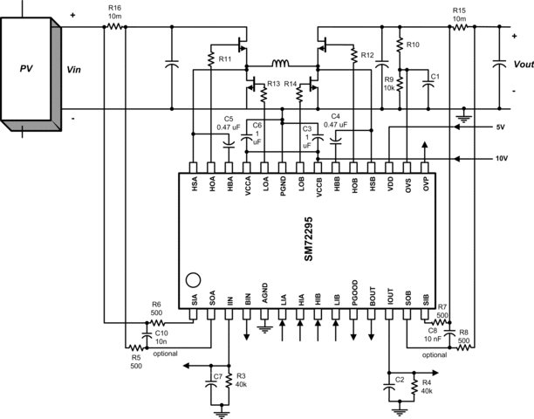
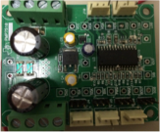
SM72295: Full-Bridge Gate Driver w/Integrated Current Sense
Features
Benefits
Dual half-bridge 100V, 3A MOSFET drivers
Independent high and Low driver logic inputs
Two integrated current sense amplifiers
Programmable gain and buffered outputs
Integrated 100V bootstrap diodes
Bootstrap supply voltage rating 115V DC
Low power consumption
Propagation delay matching
Supply rail UVLO with power good indicator
Integrated Dual Current Sense Amplifiers eliminates need for 2 differential amplifiers and reduces BOM count
Full bridge configuration reduces component count; 100V diodes allow higher wattage output
UVLO with power good indicator eliminates need for discrete supervisory chip
Applications
PV Module Level Power Management
Power Optimizers
Micro-inverters
PV Battery Charging (Li-ion, Lead Acid, NiMH)
Residential and Commercial UPS/Inverters
48-12V Bi-directional Charging System
4 Switch Buck-Boost Supply
12

Slide 13
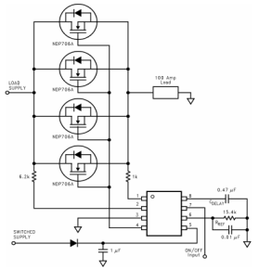
LM9061: Power MOSFET Driver with Lossless Protection
Features
Benefits
Built-In Charge Pump for Gate Overdrive of High Side Drive Applications
Fast Turn-ON
1.5 ms Max with Gate Capacitance of 25000 pF
Integrated Protection:
Programmable MOSFET Protection Voltage
Programmable Delay of Protection Latch-OFF
Remote Enable
Overvoltage Shut OFF with VCC > 26V
Withstands 60V Supply Transients
Ease and Versatility: Simple circuit design, drives any size of N-Channel Power MOSFET, and even drives multiple parallel MOSFET’s for high current applications.
Lossless Protection of Power MOSFET:
Voltage drop (VDS) across the power device is continually monitored.
Current Sensing resistor across the load is not needed for protection feature, saving on losses.
Gradual Turn-OFF: 110uA current sink discharges gate capacitance for a gradual turn-OFF characteristic to minimize the duration of inductive load transient voltages.
Applications
Valve, Relay, and Solenoid Drivers
Lamp Drivers
DC Motor PWM Drivers
Logic Controlled Power Supply Distribution Switch

